Slide 1

CSE 470 - Software Engineering Introduction
BRAC University

Slide 2
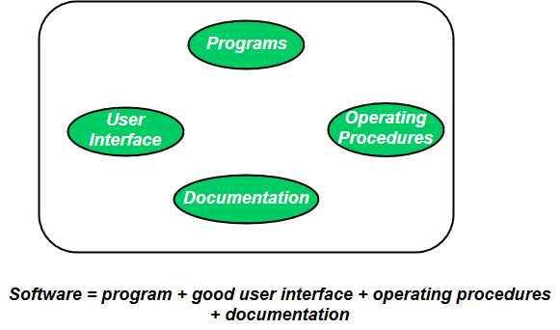
What is Software Engineering
Software → Computer program that provides useful functionalities.
Engineering → Using systematic, scientific and well-defined principles to develop solutions to large scale problems.
Software Engineering → application of a systematic, disciplined and quantifiable approach to the development, operation, and maintenance of software

Slide 3



Software Engineering Roles
User – Who actually uses
Customer / Business People – Who initiates to build it for business
Development Company/ Team – Who develops it (Management, Programmers)

Slide 4
Software Myths
Management Myths
We already have a book that’s full of standards and procedures for building software. Won’t that provide my people with everything they need to know.
My people do have state-of-the-art software development tools. After all, we buy them the newest computers.
If we get behind schedule, we can add more programmers and catch up – Mongolian Horde Concept

Slide 5
Software Myths
Customer myths
A general statement of objectives is sufficient to begin writing programs…we can fill in the details later.
Project requirement continually change, but change can be easily accommodated because software is flexible.
Cost of Change
Time

Slide 6
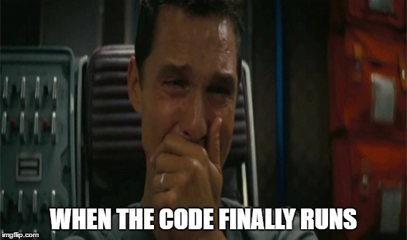
Software Myths
Programmer myths
Once we write the program and get it to run, our job is done.
A working program is a successful deliverable of the project.

Slide 7
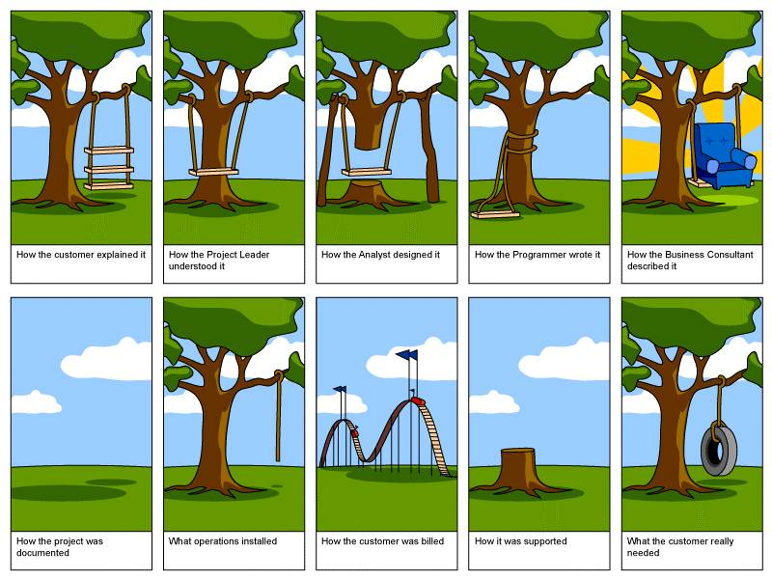
Expectation vs Reality
Reality
Expectation

Slide 8
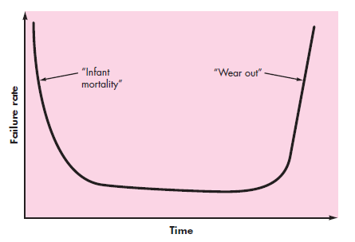


Software Engineering Importance
Hardware Failure Curve
Software is ever lasting and changing
Software Failure Curve

Slide 9

Software Engineering Importance
So, it is important because we need to develop a Good Software optimizing -
On time
On budget
With correct operation
With acceptable performance
(loading time, server capacity, etc.)

Slide 10
What Is Good Software?
Lets say Facebook, what you want from it ?
It works properly
It loads faster
It loads easily anywhere mobile, tab, pc
We love new features
Our private chats
Even my little brother can use it ☺
As developers, we want easy API’s

Slide 11
What Is Good Software?
Lets say Facebook, what you want from it ?
It works properly [Correct]
It loads faster [Performance of Loading]
It loads easily anywhere mobile, tab, pc [Resource Usage]
We love new features [Easy Maintainable and Extendable]
Our private chats [ Security ]
Even my little brother can use it ☺ [User Interface]
As developers, we want easy API’s[ Documentation]

Slide 12

You have been called for an interview.
There you found another person from a different discipline who knows coding.
He took an online course and knows OOP very well.

Slide 13


Why should I hire you with higher salary?
I am a CSE graduate with awesome coding skill. I want higher salary.
Coding is easy. I will do it for 15k/month.

Slide 14
Knowing Software Engineering
The answer is you know software engineering and the other person don’t.
By “knowing software engineering”, it means you know every aspect of making a software: (1) what is wanted from the system, (2) scope of the software, (3) developing and delivering the software, (4) maintaining and sharing your code, (5) ensuring the quality and (6) systematic update and maintenance of the software.
Just knowing how to code to build a software is never enough.
So, if the company wants to build a reliable, robust, upgradable and sustainable software you are the person who can do it.

Slide 15
What we learnt today
Software engineering is a systematic approach to develop and maintain a software.
To develop good quality software, we need to follow software engineering principles.
Knowing software engineering is very important to work in the industry.

